Slide 1
INTRODUCTION TO DATABASE MANAGEMENT SYSTEM (IDMS)
Lecture 1
Barnali Goswami
Email: barnali.goswami@sicsr.ac.in

Slide 2
What is DATABASE?
It is a collection of data which is relevant to an enterprise.

Slide 3
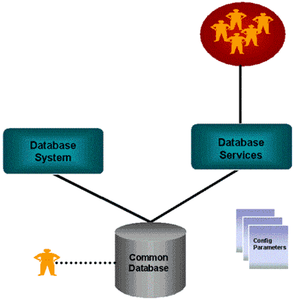
What is DATABASE MANAGEMENT SYSTEM (DBMS)?
Software designed to assist in maintaining and utilizing large collection of data.

Slide 4
Applications of DBMS
University
Bank
Railways
Airlines
Finance

Slide 5
To do
Find out as many examples application of database as possible.

Slide 6
Evolution of DBMS
Charles Bachman designed first general-purpose DBMS in early 1960s, named Integrated Data Store (basis for Network Data Model).
IBM developed Information Management System (IMS) DBMS in late 1960s (basis of Hierarchical Data Model).
In 1970, Edger Codd proposed Relational Data Model.
SQL became standard for Relational DataBase.

Slide 7

Drawbacks of traditional File System
Data redundancy and inconsistency
Difficulty in accessing data
Data isolation
Integrity problems
Atomicity problem
Concurrent access anomalies
Security problems

Slide 8
Advantages of DBMS
Data independence
Efficient data access
Data integrity and security
Data administration
Concurrent access and crash recovery
Reduced application development time

Slide 9
To do
State the differences between file based system and database management system.

Slide 10
Types of Users of DBMS
End users
Application programmers
Database implementors
Database administrator

Slide 11
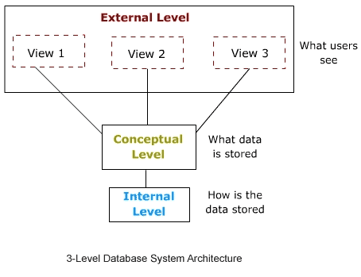
Data Abstraction
Physical/Internal level- how data are stored in memory.
Logical/Conceptual level- what data are stored in the database, and the relationships between them.
View/External level- part of database.

Slide 12
To do
Write a short note on Data Abstraction.

Slide 13
Instance and Schema
Instance is the collection of information stored in the database at a particular moment.
Schema is the overall design of the database, at an instance.
  Physical Schema
  Logical Schema
  Subschemas

Slide 14
Data Models
It is a collection of data, data relationships, data semantics and consistency constraints.
Two main models are:
  Entity Relationship Model
  Relational Model
Other models are:
  Object Oriented Model
  Hierarchical Model
  Network Model

Slide 15
Database Languages
DDL
  To specify database schema
  Used to define logical and view level schema
DML
  To retrieve information
  To insert new information
  To delete information
  To modify information
  Allows users to access/manipulate data
Eg of DDL and DML language: SQL

Slide 16

Roles of Database Administrator
Schema definition (using DDL).
Storage structure and access-method definition.
Schema and physical organization modification.
Granting of authorization for data access.
Routine maintenance.

Slide 17
Next
Data Models

